Slide 1
Coursera Capstone Project
IBM Course Data Analysis

Slide 2
Business Problem
Imagine your friend has spent many years working at various cafes and recently graduated with a degree in chemistry. Your friend invented a health drink that can substitute for coffee - it gives you energy and tastes great.
You want to team up with your friend to open up a cafe that serves you know will be successful IF you can get people in the door.
Humans are creatures of habit and you know that because there are many great coffee shops, you will have to open up your store near existing cafes. The reason why it has to be near an existing cafe is that it will reduce marketing costs - people will come to the area for coffee and since the health drink is a substitute you can convince them to try the drink.
You are deciding whether to open up the cafe in Manhattan or in the Bronx. We explored Manhattan in module 3, this capstone will explore clusters in Bronx to see if Cafes are in the top categories of any clusters.

Slide 3
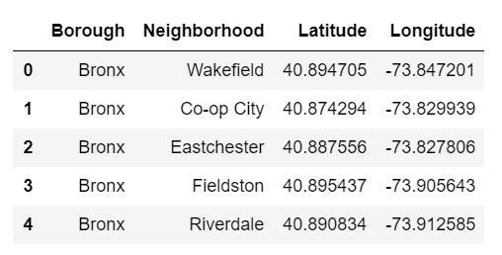
Data
To solve this problem, I will need a list of all neighborhoods in NYC (from here - https://geo.nyu.edu/catalog/nyu_2451_34572). I will need to build a data frame and find venues for each neighborhood.

Slide 4
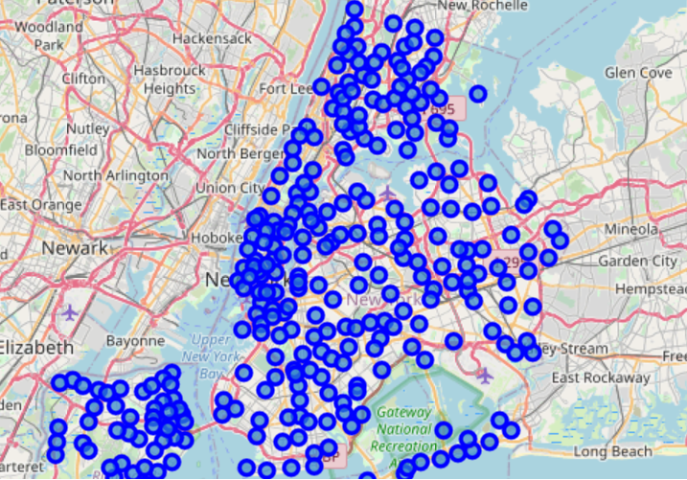
Map of New York with Neighborhoods

Slide 5
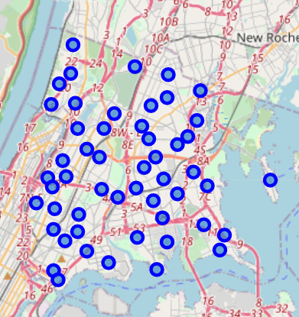
Map of Bronx

Slide 6
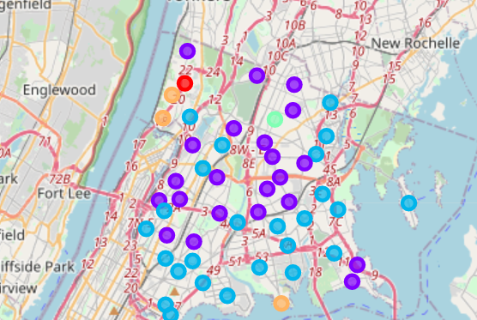
Result: Map Clusters

Slide 7
Result: Final Observation
First and second cluster contains majority of the neibourhood, based on common venues. Cluster 3-5 contain 1-2 venues per cluster.
Few observations/insights from the results:
Most neibourhoods are similar in terms of the types/categories of venues which could mean few things The population in Bronx is similar (i.e. age, occupation, etc.) across neibourhood While NYC is considered an international city, Bronx might be more American due to similar venues Only one of the neibourhood, East Tremont, where Cafe is in top 5 frequency which would indicate that it is more of a bedroom community - people go to work in other cities The final recommendation/conclusion that can be drawn from this is that you and your friend should open up a cafe in Manhattan as the first and the second clusters (Red and Purple) had cafe in the top 10 most common types of venues.

